Slide 1

FacemOji
Presented by :
Kirti Patil(2541)
Devarsh Muthe(2534)
Arnav Tambe(2563)
Shruti Netake(2537)
Mentor :
Prof. V. E. Pawar

Slide 2

Content
Introduction 3
Key Features 4
Objectives Of Work 5
Literature Review 6
Problem Statement 8
Proposed Solution 9
Technologies Used 11
System Flowchart 12
Conclusion 13

Slide 3

Introduction
Facemoji is a system that involves detecting faces in real-time using a webcam and overlaying emojis on the detected faces.
The use of emojis in digital communication is widespread, but current emojis are static and lack real-time emotional reflection.
It enhances user experience in messaging, social media, and virtual communication by making emoji interactions more expressive and engaging.
Key Highlights:
Uses face detection and expression analysis.
Ensures a fun, interactive, and intuitive user experience.
Works in real-time, making it ideal for live applications like video calls and chatbots.
Can be integrated with various platforms like WhatsApp, Instagram, and Snapchat.

Slide 4

Key Features
Face Detection:
Uses OpenCV and other models to accurately detect faces in live video feeds.
Identifies the face region from a larger image for further analysis.
2. Facial Expression Recognition:
Detects emotions like happy, sad, angry, surprised, neutral, etc.
Emoji Mapping:
Automatically overlays custom emojis on the face reflecting real-time facial expressions.
Adjusts mood and facial attributes to match the detected emotion.
Real-Time Processing:
Ensures quick and efficient working for interactive applications.
Can be integrated into messaging apps, social media, and virtual meetings.

Slide 5

Objectives Of Work
Efficient & Accurate Processing–
Optimize the system for fast and reliable emotion detection within a standalone application.
Emoji Mapping-
Detect the face in real time using the webcam. Resize the emoji to fit the size of the face. Ensure the emoji is centered on the face and scales correctly with different face sizes.
Real-time Face & Emotion Detection –
Develop a system that accurately detects human faces and recognizes emotions such as happiness, sadness, anger, and surprise using Python-based libraries and machine learning models.

Slide 6
Literature Review
Author and Year | Title | Source | Key Points
M SHWETA SINGHA and DEEPSHIKHA (2021) | Emoticon Generation using Facial Emotion Recognition | https://sist.sathyabama.ac.in/sist_naac/documents/1.3.4/b.e-cse-batchno-202.pdf | The objective of this project is to develop Automatic Facial Emoji Generation System which can take human facial images containing some expression as input and recognize and classify it and generate emoji.
Prof. Balaji A. Chaugule, Bhakti Sambal, Janakee Shelke, Aachal Chimankar, 5Unnati Shinde (2014) | A Deep Learning Model for Facial Expression to Emoji Generation and Statistical Representation | https://www.jetir.org/papers/JETIR2404H28.pdf | The “A Deep Learning Model for Facial Expression to Emoji Generation and Statistical Representation” can quickly recognise and categorise facial expressions and associate them with appropriate emoji portrayals. It examines face images collected from webcams or video feeds, using a combination of computer vision methods and powerful deep learning algorithms, to provide real-time predictions about the emotions represented. This endeavour aims to provide an immersive user interface experience by overlaying recognised emotions with corresponding emojis on the user's face.

Slide 7
Literature Review
Author and Year | Title | Source | Key Points
Ramya. G. Franklin, Dr. A.C. Santha Sheela (2022) | Emoji Generation Using Facial Emotion Classifier | https://www.philstat.org/special_issue/index.php/MSEA/article/download/156/155/155 | This project creates a deep learning model that can classify a given picture of a human facial expression into one of the seven essential human emotions. The classified emotion would then be mapped to an emoji or avatar. Used CNN to develop a robust model for generating emoticons. Used the Haar cascade classifier for face detection before using the deep neural classifier, and then the neural classifier for expression classification.
Rohit Karmakar, Subhadip Das, Angshuman Rana, Kunal Roy (2023) | Synopsis of Facial Emotion Recognition to Emoji Conversion | https://www.irjet.net/archives/V10/i12/IRJET-V10I1230.pdf | This project centers on the creation of a FER(facial emotion recognition) system utilizing OpenCV, TensorFlow, and NumPy. OpenCV furnishes a robust framework for analysing images and videos, TensorFlow provides a comprehensive platform for machine learning, and NumPy facilitates efficient computation with expansive, multi-dimensional arrays and matrices.

Slide 8
Problem statement
The increasing demand for interactive video applications—such as virtual meetings, live streaming has led to the need for seamless integration of digital elements (such as emojis) with live video.
A common challenge arises when attempting to overlay emojis onto detected faces in a way that is natural, responsive, and visually appealing.
The core problem lies in the complexity of dynamically integrating emojis with real-time face detection systems, requiring solutions that are both accurate and efficient while maintaining a high-quality user experience.

Slide 9

Proposed Solution
The project aims to develop a Python-based system that integrates computer vision and AI to detect facial expressions and generate corresponding personalized emojis in real-time.
1.Face Detection
Uses OpenCV & Haar Cascade classifiers to accurately detect human faces from live video feeds.
Works on real-time webcam feeds for dynamic interactions.
Ensures high detection accuracy by filtering out background noise and irrelevant objects.
2.Facial Expression Recognition
Implements DeepFace and CNN-based emotion recognition models.
Identifies key emotions such as:
😊 Happy
😞 Sad
😠 Angry
😲 Surprised
😐 Neutral
Uses feature extraction techniques to analyze facial landmarks (eyes, mouth, eyebrows) for precise classification.

Slide 10
Proposed Solution
3. System Workflow :
User faces the camera.
Face is detected and extracted for processing.
Emotion analysis determines the current mood.
A corresponding emoji is overlayed on the face in real time.
Emoji updates dynamically as facial expressions change.
4. Emoji mapping:
Maps detected emotions to a set of predefined emoji templates.
Dynamically adjusts features like mouth shape, eyes to match the user's facial expression.

Slide 11
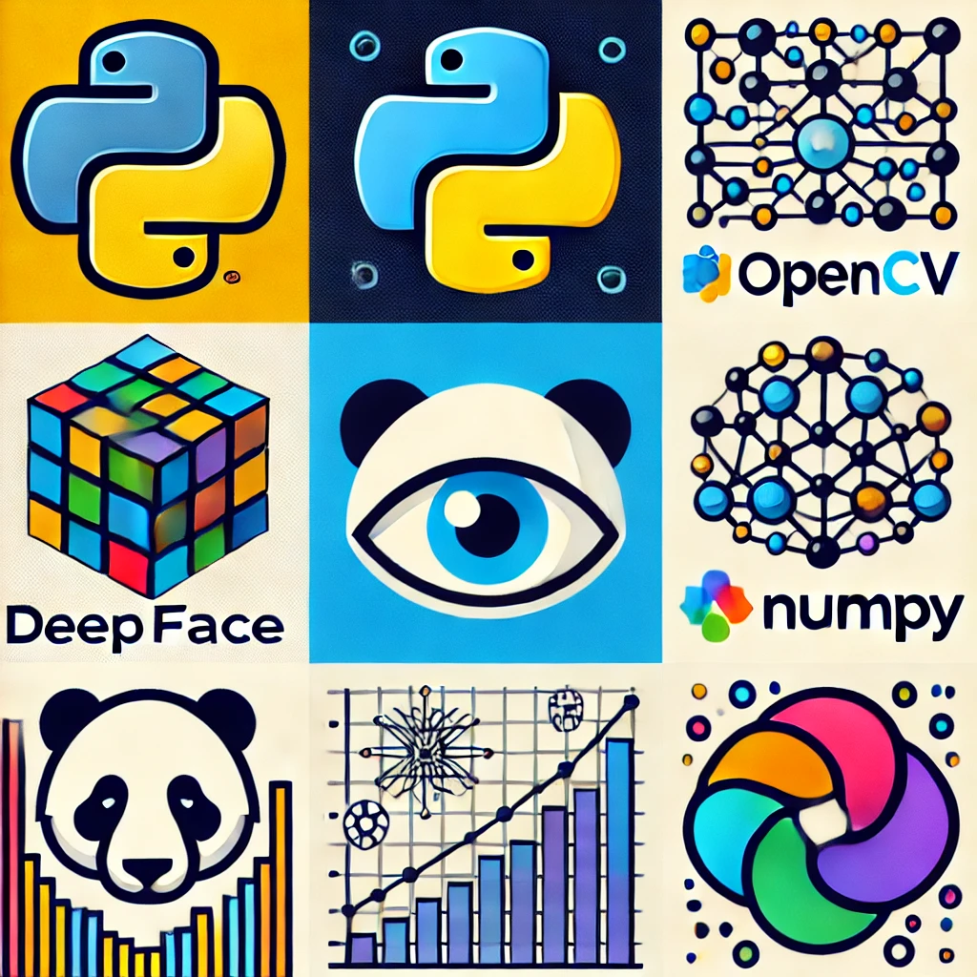
Technologies used
Python – Core language for implementation.
OpenCV – For face detection and image processing.
DeepFace – Emotion recognition model for analyzing facial expressions.
Machine Learning – Trained models for detecting emotions (happy, sad, angry, neutral, etc.).
Haar Cascade & CNNs – Used for face recognition and feature extraction.
NumPy & Pandas – Data handling for efficient processing.

Slide 12

System Flowchart
Webcam
(Capture video frames from the webcam)
Overlay emoji on the face in the video frame
(Alpha Blending)
Deepface Emotion Analysis
(Perform emotion analysis on the detected face)
Use Opencv to handle image frames
User
Haar Cascade Classifier
(Detect Faces)
Map detected emotion to corresponding emoji image

Slide 13

Conclusion
This project demonstrates an innovative approach to real-time facial expression analysis and mapping user emotions to corresponding emojis using computer vision.
By leveraging face detection and emotion recognition, the system accurately maps user emotions and overlays corresponding emojis on the face, enhancing digital expression and interaction.
The project highlights the practical application of facial recognition, offering an engaging and interactive experience.
Future Scope
3D & Animated Emojis – Generate animated emoji expressions for a more dynamic experience.
Voice & Gesture Integration – Combine facial expressions with voice tone and gestures for better emotional analysis

Slide 14
“Thank You”

